Slide 1
CHAPTER 5 Predictive Control with constraints 2 Constraints in optimisation
Anthony Rossiter

Slide 2
Background
Having established that there are clear benefits from including constraint information systematically into a control design, the next task is to determine how this can be done.
Predictive control is based on the optimisation of predicted performance with respect to some pre-defined d.o.f. within the predictions.
In principle it is straightforward to add constraints to this optimisation.
This video will begin by showing how constraints impact on a QP optimisation.

Slide 3
Quadratic performance index
Earlier videos have clearly demonstrated that a typical MPC performance index has a quadratic dependence on the d.o.f.
A typical quadratic can be expressed as follows.
The optimisation is given as:

Slide 4
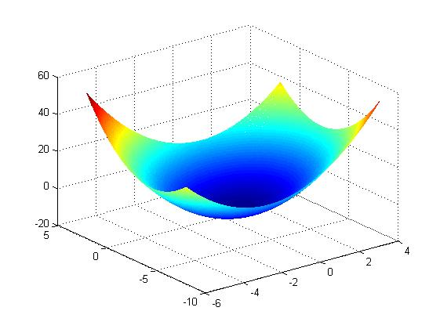
Illustration of J in phase plane
It is useful to plot some contours of J in x-space to get an impression of how J changes with x.
Unconstrained optimum

Slide 5
Adding constraints
What happens to the minimum value of J if we insist that some constraints are met.
A simple illustration will help here.
Add x>1.5
Optimum moves
J INCREASES
Add x+y>1.5
Add x+0.2y>1
NO EFFECT!

Slide 6
Summary
The optimisation illustrated here was:
Noted that the top two constraints influenced the optimum solution, but the 3rd constraint was redundant.

Slide 7
Terminology
A constraint is active if its inclusion affects the constrained optimum.
A constraint is inactive, or redundant, if is inclusion does not affect the optimum.
The constraints which are active will depend upon the position of the unconstrained optimum (and shape).
The number of active constraints can be 1 or 2 for this case. Optimum on an edge or corner.

Slide 8
Using MATLAB to solve a constrained optimisation
There are also several options not discussed here. See help quadprog
The optimisation discussed here is a quadratic program, this has a quadratic performance index and linear constraints.
Typical notation would be something like:
However, MATLAB prefers the following notation.
Next use:
Xopt=quadprog(S,b,M,d)

Slide 9
Illustration of MATLAB
See the file video5_2_example1.m in the constraints examples folder

Slide 10
Other illustrations from video5_2_example1.m

Slide 11
Other illustrations from video5_2_example2.m

Slide 12
Similar insights carry over to the higher dimensional cases but clearly these are harder to illustrate in figures.

Slide 13
Counter intuitive results video5_2_example3.m
Constrained optimum lies on lower limit for x1.
If x1 is the first control move, this means go in the totally opposite direction to what the unconstrained case is telling you!
Unconstrained optimum exceeds upper limit on x1.
Saturation control could be very poor indeed!
Lower limit on x1.
Upper limit on x1.

Slide 14
Summary
A failure to take proper account of constraints during a feedback design can have several undesirable consequences.
This video has introduced the quadratic programming optimisation.
It has been demonstrated that the inclusion of linear constraints changes the optimum, and not always as we expect.
We have illustrated how the insights from these constrained optimisation show the ‘best’ strategy can be (not must be) far away from a saturation policy.

Slide 15




Anthony Rossiter
Department of Automatic Control and Systems Engineering
University of Sheffield
www.shef.ac.uk/acse
© 2014 University of Sheffield
This work is licensed under the Creative Commons Attribution 2.0 UK: England & Wales Licence. To view a copy of this licence, visit http://creativecommons.org/licenses/by/2.0/uk/ or send a letter to: Creative Commons, 171 Second Street, Suite 300, San Francisco, California 94105, USA.
It should be noted that some of the materials contained within this resource are subject to third party rights and any copyright notices must remain with these materials in the event of reuse or repurposing.
If there are third party images within the resource please do not remove or alter any of the copyright notices or website details shown below the image.
(Please list details of the third party rights contained within this work.
If you include your institutions logo on the cover please include reference to the fact that it is a trade mark and all copyright in that image is reserved.)

